Slide 1

V450: Project Management & Implementation
Class 8
Scope of Work II
Pre-Planning
“Unless commitment is made, there are only promises and hopes; but no plans.” – Peter F. Drucker."

Slide 2
Warm-Up
Which superpower would you prefer, to be able to fly or to be able to become invisible?
Would you have five dogs or five cats? Why?

Slide 3


Slide 4
Pick a project.
Individual Skills Inventory due Sunday @ midnight
My User’s Manual.
Phase 1: Initiating
Phase 2: Planning.
Phase 3: Executing.
Phase 4: Monitoring.
Phase 5 Closing.
Self & Peer Evaluation.

Slide 5

Name the Big 5 Pre-Questions.
Why would some new PMs have trouble asking them?

Slide 6
Today’s Objectives
Realize that all key stakeholders will have expectations about a project. Find out what they are – early & in detail.
Know the difference between requirements and expectations.
Understand how to set both goals and objectives.

Slide 7
ꚙ Off to a fast start, slowly. ꚙ
Today’s
PM Problem

Slide 8
You've just been hired as PM for a new, high-stakes project: developing a custom Client Relationship Management (CRM) system called "Evergreen" for a long-standing client. Your predecessor retired, leaving behind a project that's been in a holding pattern for months.
The only documentation you can find is a signed contract that states, "Branch Financial requires a new CRM system to improve client relations and streamline sales processes." There are no detailed requirements, no documented scope, and no project charter. At your first client/team meeting, no one agrees on the goals.
Your project team is ready to start, but they're confused. They have a general idea of a CRM, but without a clear direction, they've been doing preliminary work based on assumptions. Morale is low, and the client is getting impatient, believing the project should have already started in earnest.

Slide 9

What’s the main thing that’s missing? Name the first 3 immediate actions you would take.

Slide 10

Big things are missing from this project's initiation and planning phases.
You are missing specific information that you now need to gather.
Start with the conflicting expectations among the client's stakeholders. What strategy would you use?
Next, reset expectations without damaging the relationship or further delaying the project.

Slide 11

From what you already know about projects and human nature, what are the top two reasons PMs say most projects fail?

Slide 12
When PMs were surveyed why projects fail, they gave two main reasons:
No. 1 reason was perpetual scope creep.
No. 2 was a lack of understanding of the scope or clients' vision..
Notes:
Read.

Slide 13
Scope management, or rather the lack of it, is one of the biggest reasons for project failure.
Correctly defining what is and is not included in the project is absolutely foundational to good project management.
Even projects with the right expertise, schedule, budget and satisfied clients can get derailed by “scope creep.”
Notes:
Read

Slide 14

Scope creep is uncontrolled growth in what work needs to be done.
It typically occurs gradually – and seemingly innocently - as changes or new features are requested after the project begins.
It almost always results in delays, cost overruns or diminished quality.
Notes:
Read.

Slide 15
Give an example you’ve seen of scope creep in plans for a vacation, home projects, the weekend, etc.?

Slide 16
Lack of understanding of the scope or clients' vision comes down to one of humankind’s oldest problems – and easiest to fix – poor communication.
Notes:
Say nothing.

Slide 17
Why is it so important to state was is not in a project, isn’t that kind of a downer? Won’t the boss or client think you’re shirking?

Slide 18
Even after answering The Big 5 Questions, the wise PM still doesn’t launch into detailing the entire planning process.
They have additional prep work to do to. Before a PM starts on the scope of work, they must first determine some ground rules.
Notes:
Read.

Slide 19
Big 5 Pre-Questions/Pre-Planning
↓
Requirements
↓
Expectations
↓
Goals & Objectives
↓
Deliverables
↓
Scope of Work Action Plan
↓
Work Breakdown Structure
The Big Plan
Notes:
Here is the flow of works when preparing the scope for a project.

Slide 20
Start by planning for a plan.
Planners have the illusion that the sooner they imagine some goals and get those goals on paper, the sooner they’ll achieve those goals, as well. So that’s where they start – fantasizing about goals.
Too dangerous – it’s like going on a trip without a map and then complaining that you didn’t get where you wanted to go.
Notes:
Start by realizing you are officially planning, and official planning doesn’t start with the project itself. It starts with the PM’s environment.

Slide 21
Expectations must be managed
from the start.
Expectations are managed
in the scope of work..
Everybody’s expectations.
Notes:
Read.

Slide 22

Requirements

Slide 23
Requirements v. Expectations
Requirements are necessities; things that must be completed up to a standard before a project is considered complete. They are usually non-negotiable in the scope of work.
Expectations are broader and squishier. Expectations are the client’s strong belief that something will happen during or because of the project.
“I just thought …”
“I naturally assumed …”
Notes:
Read.

Slide 24
Requirements are tasks or conditions that must be completed to finish the project successfully.
They can include regulations, laws, product features, quality, services or even processes.
Federal law.
State Law (comp plans).
Required by Funder.
Required by client (timeline, specific stakeholders, etc.).
Notes:
Spend time finding out the requirements, which can include everything from federal regulations to rules set by the company you work for.

Slide 25
Requirements help define the quality aspect of the time-cost-quality triangle and ultimately define the full and detailed scope of the project.
They should therefore be as detailed as the people specifying them need them to be.
Notes:
Say nothing.

Slide 26
Are there predetermined requirements?
Project requirements
Business requirements
Quality requirements
Stakeholder requirements
Solution requirements
Functional requirements
Transition requirements
Regulatory requirements
Political requirements
Notes:
Say nothing.

Slide 27
The requirements for technical or complex project may be long and detailed: comply with all ISO codes, complete compatibility with system mainframe, etc., etc.
For non-technical projects, like community development plans, the requirements may be more general: meet federal requirements for public notification, community meetings, etc.
Make sure you understand both legal/technical requirements and client requirements.
Notes:
Make sure you understand both legal/technical requirements and client requirements.

Slide 28
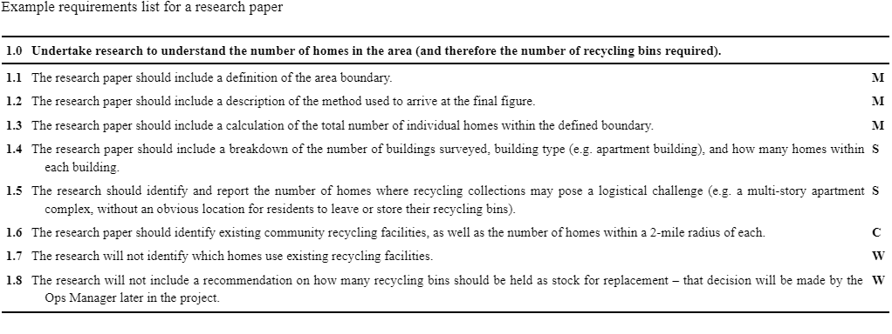
Notes:
Here’s an example for requirements on a research project about starting recycling pick-ups in a community.

Slide 29
Expectations

Slide 30
Expectations are a critical measure of success.
These expectations are the central driving factor for client’s decisions and satisfaction level.
Notes:
Expectations are a critical measure of success.

Slide 31
Expectations
must be managed
from the start.
Notes:
Read.

Slide 32

Client’s expectations are rarely clear – at first
Notes:
Say nothing.

Slide 33
Oddly enough, clients do not always make their expectations clear – but they will arise later. For example:
Required by community (diversity, certain neighborhoods).
Required by Patron (political cover).
Notes:
Oddly enough, clients do not always make their expectations clear – but they will arise later.

Slide 34
Not all expectations are of equal importance.
If you get uncertain or conflicting expectations, do a MoSCoW analysis. Ask the client to define what the project:
Must-Have
Should-Have
Could-Have
Won’t-Have
Notes:
Read.

Slide 35
Objective: Move all IT equipment from the old office, installing it in the new office.
Must: Every user should be able to log on to their computer in the new office and access their files.
Should: Any specialist settings or functionality (e.g. access to a specific printer) should be migrated and not require additional configuration.
Could: Any broken or faulty keyboards and mice should be replaced as part of the office move, provided they are clearly labeled.
Won’t: The project will not replace any computers. Existing computers will simply be moved to the new office.
Notes:
Here’s an example of a MOSCOW list for replacing a company’s computer system.

Slide 36

MoSCoW your requirements for this semester at IU: schoolwork, money or social life?
Must-Have
Should-Have
Could-Have
Won’t-Have

Slide 37
What problem might arise if the client is too specific at the start about what they want as an outcome for a planning project?

Slide 38
Being too specific – such as their must be exactly 11 meetings all held between 2 and 5 p.m. on Tuesdays - runs the risk of removing all flexibility from a project.
Notes:
Read.

Slide 39
Caution
Expectations and requirements define the solution – not the other way around. This trap occurs when people already have an idea about the solution. So, they to lead the witness by building elements of their intended solution into the requirements.
Once you have a solution, it's much harder to find a solution. If you start with a solution already in mind, rather than a requirement, you risk missing alternative solutions that may be cheaper, quicker to deliver, or more fit-for-purpose.
Notes:
Don’t speak.

Slide 40
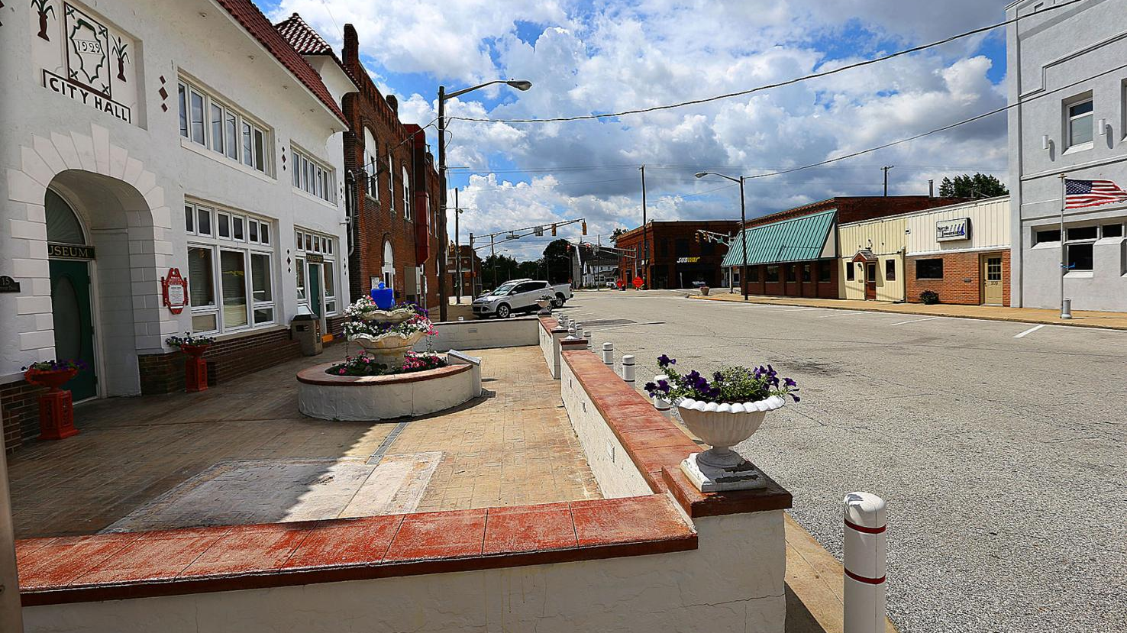

Slide 42
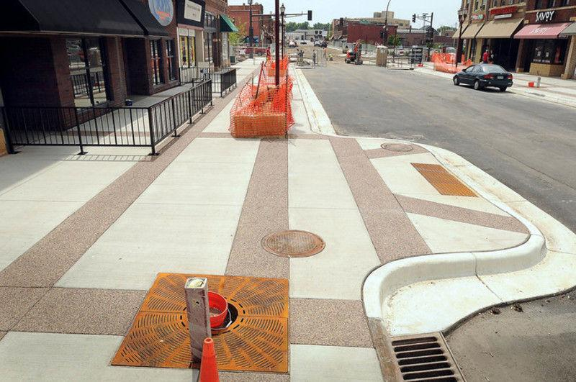
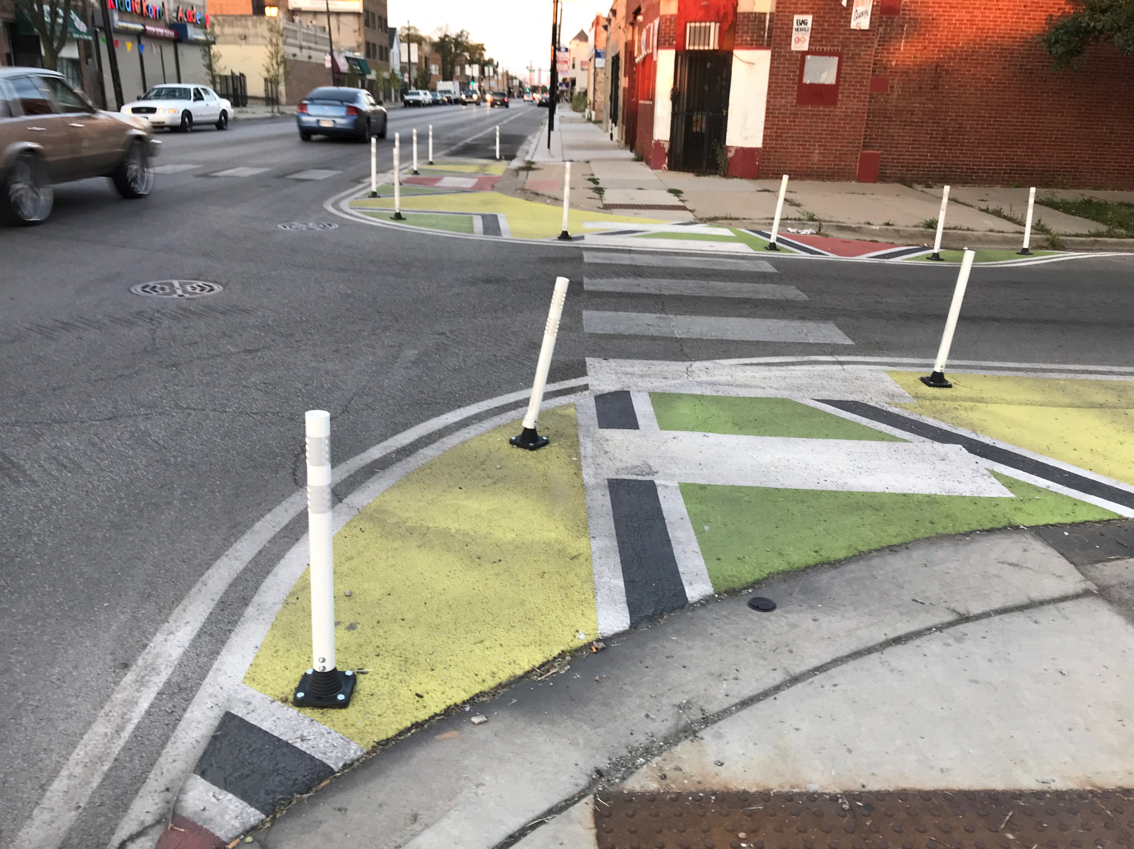

Slide 44
Must meet Client’s Expectations.
Ask – straight out. “What do you need to get out of this project?”
What would a successful project look like? A failure?
Notes:
Don’t be shy at this stage. Ask – straight out. “What do you need to get out of this project? What are your expectations?”

Slide 45
Managing Expectations: Clients
Set objectives, and point to them during every single conversation.
Be transparent about what you can and cannot accomplish.
Steady communication during bad times and good.
Under-promise and over-deliver. Don’t say, “We might be able to do that,” if you know you can’t. Build in some cushion for the unexpected, and then deliver ahead of time.
Notes:
Here’s a few tips on drawing out expectations form a client.

Slide 46

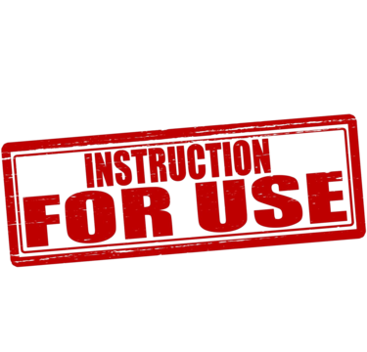
Expectations
Make this a concrete item on your prep to-do list.
“What’s the biggest thing you hope comes out of this project?”
“What’s your biggest fear? What could go wrong?”
“What are other people expecting of this project?”
“What’s your MoSCoW for the project?”

Slide 47
Goals & Objectives

Slide 48
People use the terms interchangeably, but the main difference comes in their level of concreteness.
Goals have no set way to measure; you can never say for sure that you have definitively achieved them.
Objectives can be measured. Simply phrase your objective in the form of a question. For example, ‘I want to accomplish x in y amount of time’ becomes ‘Did I accomplish x in y amount of time?’
Notes:
People use the terms interchangeably, but the main difference comes in their level of concreteness.

Slide 49
Goals help you set your priorities.
Goals set to be achieved over a long period.
Goals motivate you to act.
Goals give direction to your efforts.
Goals support decision-making.
Notes:
Read.

Slide 50
Objectives measure your progress toward your goal.
Objectives offer a sense of achievement.
Objectives help in making difficult decisions.
Objectives help you understand what is expected of you.
Notes:
Read.

Slide 51
Goals and objectives work in tandem to achieve success. If you create goals without clear objectives, you’re in extreme danger of not accomplishing your goals.
Example:
Goal: “Provide excellent customer service.”
Objective: “Reduce customer wait time to one minute.”
Notes:
Read.

Slide 52

Notes:
A handy formula for objectives is to make them SMART.

Slide 53
Goal: I want to help my department stay on budget this year.
Specific objective: “I will distribute a budget report."
Measurable objective: "I will distribute a budget report that shows our department’s current expenses in comparison to our allotted annual budget.“
Achievable objective: "I will distribute a budget report that shows our department’s current expenses in comparison to our allotted annual budget and I will highlight areas where we are overspending.“
Relevant objective: "I will distribute a budget report that shows our department’s current expenses in comparison to our allotted annual budget and I will highlight areas where we are overspending.
Time-based objective: "Each month this year, I will distribute a budget report that shows our department’s current expenses in comparison to our allotted annual budget.
Notes:
Here’s an example.

Slide 54
Recipe for Good Objectives
1. Articulate concerns and wishes.
2. Convert concerns to objectives.
3. Structure and classify (time, money, etc.).
4. Create objectives hierarchy (prioritize).
5. Create measurable attributes for each objective.
6. Repeat as needed.
Notes:
And here’s some steps to take.

Slide 55
Deliverables

Slide 56
Deliverables are what the client ends up with - products or services created or performed as part of a project.
They are the tangible or intangible outcomes that help achieve the project objectives.
For example, a deliverable for a website development project could be a wireframe, a prototype or the website itself.
Notes:
Deliverables are what the client ends up with - products or services created or performed as part of a project.

Slide 57
What problem might the PM pushes so hard to get ahead of the schedule, that they end up turning the whole project in at once?
Notes:
Think about this problem for a moment.

Slide 58
Don’t turn in everything all at once at the end.
To avoid overwhelming a client, and to ensure you’re still aligned with the goals, divide the project into smaller components that you deliver one at a time throughout the project.
Get approval for one deliverable before moving on to the next.
Notes:
Read.

Slide 59
For example, as a consultant for a community development project I will have these deliverables, each synched with billing point$:
Vision and Goals
Demographic Profile
Evaluation of Existing Conditions
Stakeholder & Public Input
Draft Recommendations
Adoption of Final Plan
Notes:
For consultants, the nice thing about having several deliverables is that they get paid upon completing each one.

Slide 60
Pre-Planning Stage
Answer Big 5 Questions.
Perform R&D for new approaches and insight.
Determine official Requirements.
Meet with client and team to set Expectations.
Create goals of objectives.
Determine the set of Deliverables.

Slide 61


Start at the End …
Then Go Farther

Slide 62
Some new project managers make the mistake of starting a project at the beginning: “OK, what do I do first?” Then start building out, step by step.
I think that’s a mistake because the real questions is: “What do I want to happen at the end of this project?”
Increase the chances of making it successful at the start by stretching your imagination out farther – to what it will look like when the project is complete.

Slide 63
Farther means imagining what is left after you are done with the project.
Is the system running? What ’s likely to break down? How is so-and-so doing with your implementation plan?
By starting at the end you can:
mentally prepare yourself for problems - and success.
map out the specific milestones you need to reach.
identify where to be particularly energetic or creative.

Slide 64
Most plans aren't plans; they are just high-level ideas.
As a result, a planning process can be completed successfully, but not a damn thing follows from it.
Untold thousands of plans can be found in pristine condition, untouched atop of filing cabinets or deep in old computer files.
The best plan is a completed plan.

Slide 65
Expectations must be managed from the start.
As always, start with yourself: What are your expectations?
What would make this project a success for you?
Where are you starting from?
How might your expectations influence the PM Triangle?

Slide 66
Focus on destination,
not the journey or vehicle
(not very Zen like, I know).
Otherwise, you’ll happily boast that you completed the project on time and under budget, but when you check back 6 months later ... zilcho. After you left, nothing happened.

Slide 67
Step 1: Honestly assess YOUR Ultimate, Supreme, Top No. 1 Goal
A satisfied key client (even if other stakeholders aren’t fully satisfied).
Staying under budget (even if the budget has to be “revisited” later).
Making the deadline (even if holes starting showing up in the process).
Covering Your Ass (‘I was told to follow this exact procedure, and I did so).
Unto Thy Own Self (‘You’re not going to like it, but here are the results’).
The Resume Builder (“I’m going to launch my career off this project’).

Slide 68
Step 2: Identify in detail the Most Likely, Most Vexing Obstacle(s)
Vague client (‘I’ll let you know when I don’t like it).
Distracted client.
Inadequate time, teammates or budget (they won’t make deadlines).
Squishy goals (“Let’s just see what we find’).
We need a scapegoat.
Inertia and indifference.

Slide 69
Step 3: Plan where to apply extra attention & energy
For vagueness & distracted: Weekly updates & ‘Show of hands’
Inadequate resources: Make the vital cuts decisively and early
For procrastinators: Fudge (lie) about the due dates
Squishy goals: Weekly updates & ‘Show of hands’
Scapegoat: Find a Patron
Inertia/Indifference: Re-energize; Reassess; Don’t give up

Slide 70
Step 4: Write a Real Time timeline. Make it reflect:
The physical world (holidays, summer vacations, etc.)
Client schedules (council meetings, conferences, etc.)
Partner schedules (Pat is swamped, etc.)
Client & Partner Personalities (procrastinators, detail oriented, etc.)
Legal notice schedule requirements
Agenda schedule requirements

Slide 71

Handing Off the Project

Slide 72

Handing Off the Project

Slide 73
A project absolutely must have expressed benefits and objectives, as these will define the project and be the measure of its success.
The benefits of a project describe why we are undertaking the work: a new strategic plan, a satisfied public, etc.

Slide 74
The Client/Sponsor must be the person who receives the benefits. Otherwise, the planning process might be a success but the project itself is not carried out. This is common in government and other top-down approaches.
Example: The mayor hires a consultant to do a downtown revitalization plan to be carried out by a volunteer group. What could go wrong?
The project is handed off to the mayor, who considers it done and moves on. The local group’s role is now over, and they’re left with not enough resources to push on with implementation.

Slide 75
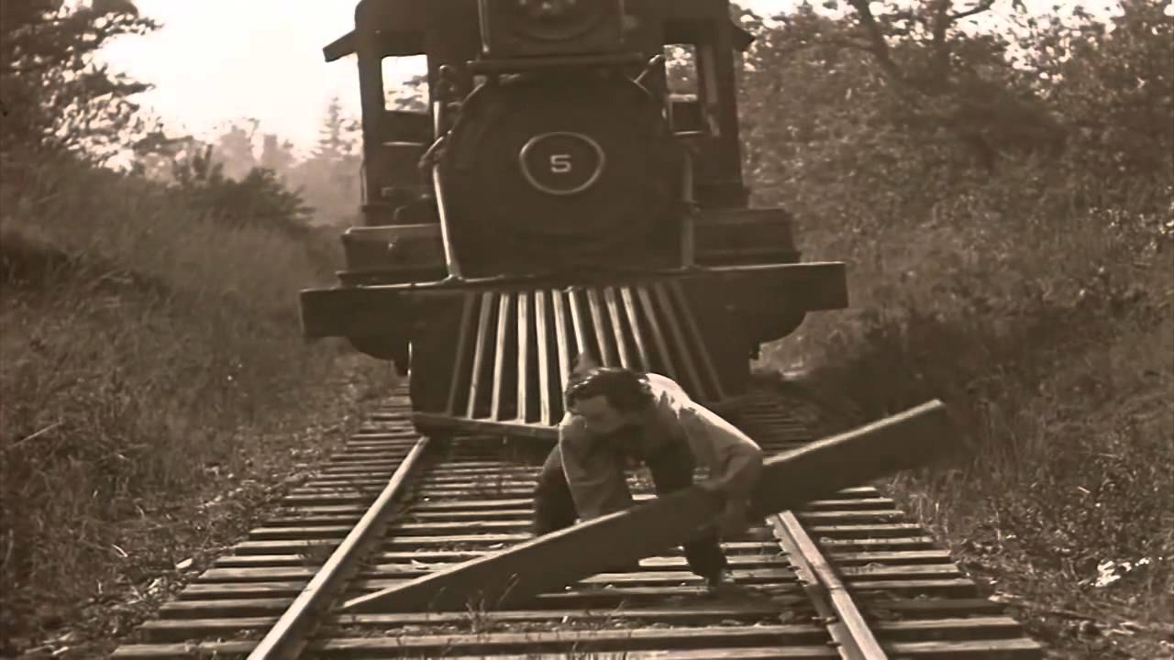
Clearing the Tracks

Slide 76
Clearing the Tracks
https://www.youtube.com/watch?v=LaApqL4QjH8

Slide 77
How to Hand Off a Project
Picture the end product – mentally test it.
Clear the tracks.
Make the hand-off date clear.
Provide documentation.
Get the official sign-off.
Stay around for training.
Let this project go and move on to the next one, but ...
Later, wander back over to check in.

Slide 78


Slide 79
Class 9 Check-In

